Slide 1


Slide 2
Windows 10 pro ulra os
Install the shraped way (you can change it to round in settings)
Install the rounded way
(you can change it to shrap in settings)

Slide 3
Coping files 100% making oobe 100% making destop 100% installing the web ! Something went wrong you can skip

Slide 4
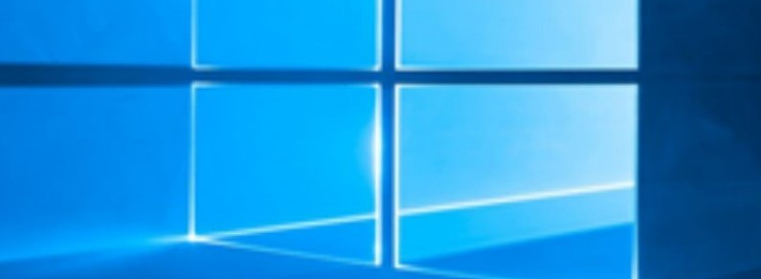

Slide 5
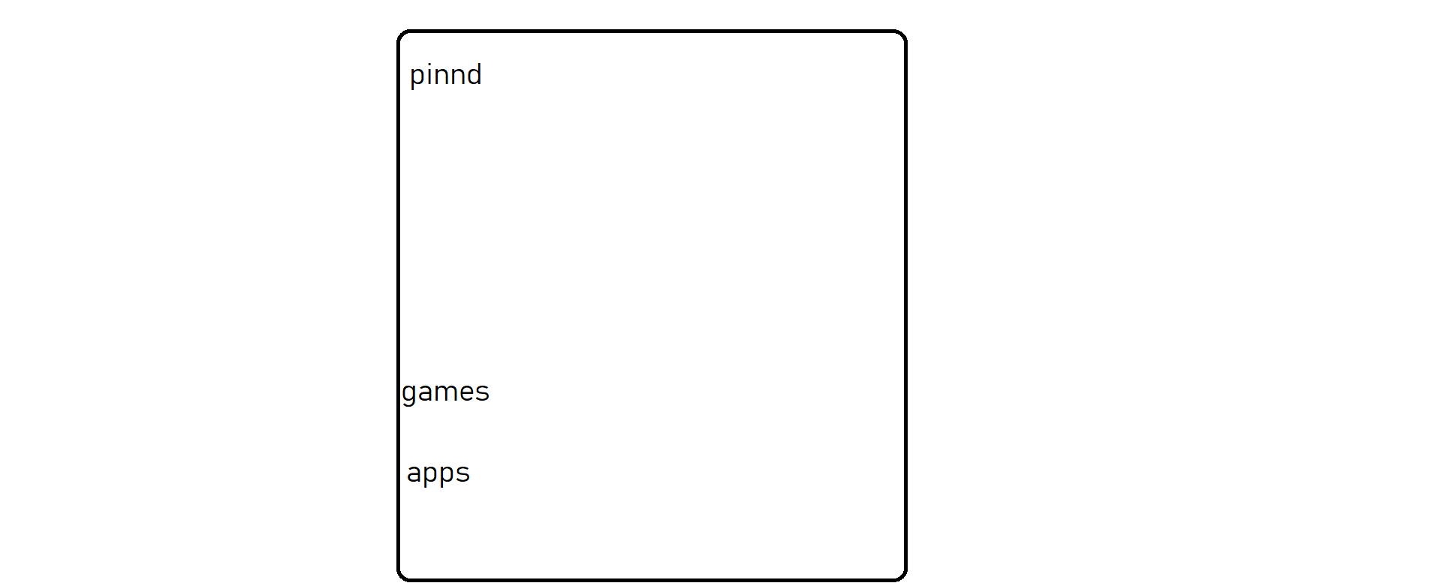



This Photo by Unknown Author is licensed under CC BY-SA
This Photo by Unknown Author is licensed under CC BY-SA-NC

Slide 6
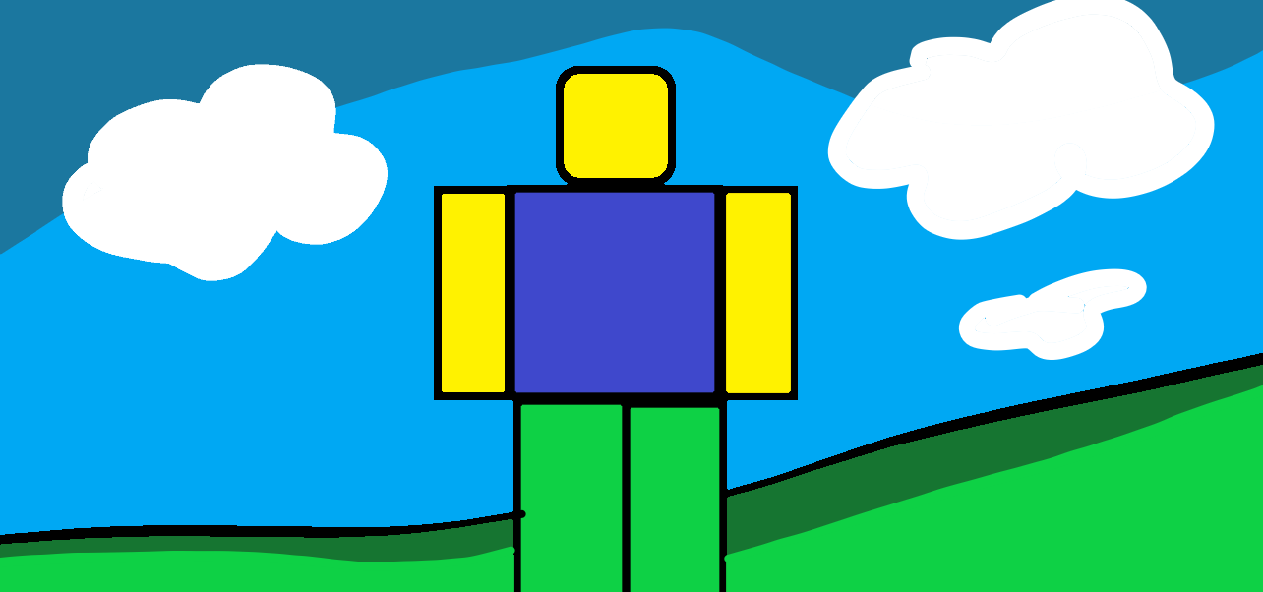

Slide 7
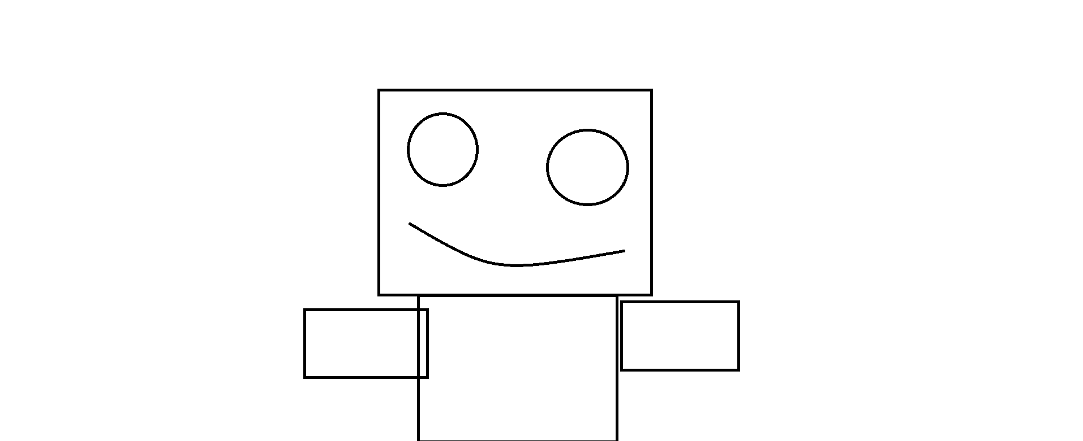

Slide 8
